Slide 1
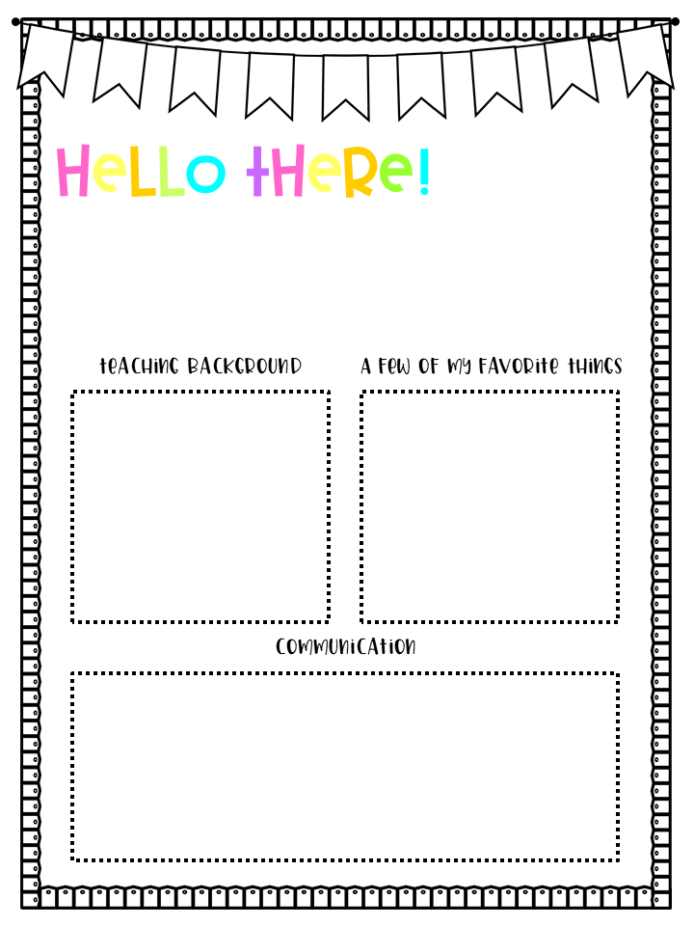
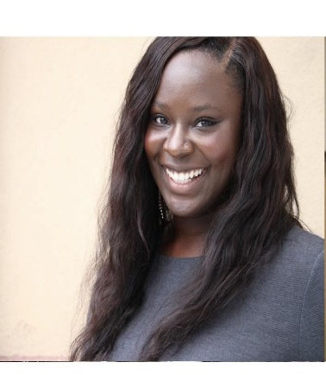
INSERT
PICTURE
HERE
My name is Ashley Parks
and I am ecstatic to be your child’s Special Education teacher for this 2022-2023 school year here at Diamond Lakes Elementary!
Ashley Parks is committed to student success inside and outside of the classroom. She is a dedicated 6th year teacher. She has currently taught 2nd grade for 4 years and 4th grade for 1 year. She believes that “Every child has the capacity to learn, we as teachers have to provide them with the opportunity to do so”. Ashley helps shape the future by teaching at her local Boys and Girls Club as a Lead Teacher and participates in her Leadership Team at her school to improve our student success rate. Through the many roles she plays as a teacher, she is also a motivator to the current youth. She strives to better her society through encouraging, promoting creativity, challenge driven, and awe-inspiring the adolescence which shapes future societies to come.
Colors: pink
Foods: confetti berries and chocolate covered strawberries
Drinks: Starbuck’s Coffee or
Tropical smoothie
Hobbies: TRAVELING, spending time with family and friends
Stores: Aerie and American Eagle
Email: parksas@richmond.k12.ga.us
You can also communicate with me through your child‘s ClassDojo account!
If you have any questions, concerns, or want to inform me of anything you would like me to know about your student, please do not hesitate to contact me. Thank you so much and I am really looking forward to getting to know you and your student!

